Slide 1

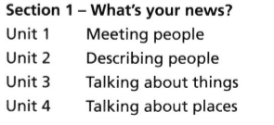

WEEK-1

Slide 2
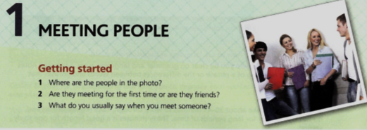
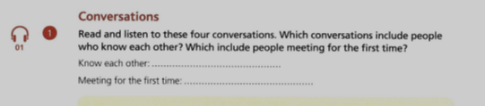

Slide 3
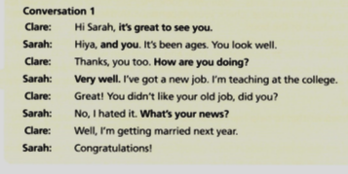

0.09-0.46

Slide 4
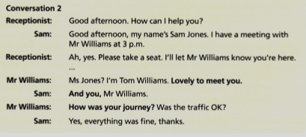
0.48-1.23

Slide 5
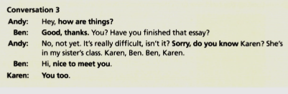
1.24-1.52

Slide 6
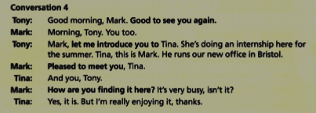
1.53-2.27

Slide 7
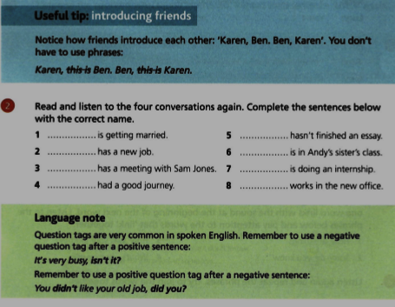

Slide 8
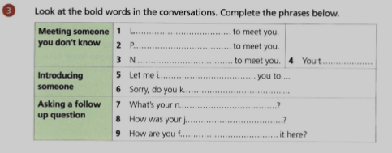

Slide 9
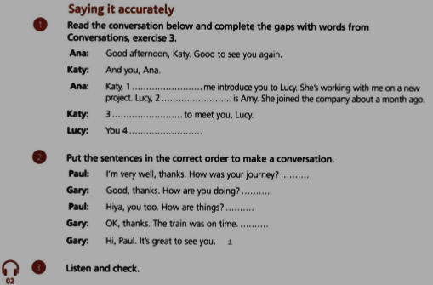

Slide 10
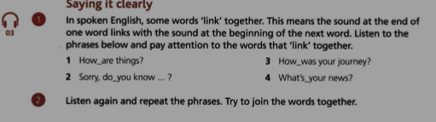
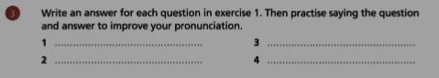

Slide 11
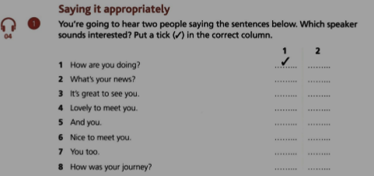

Slide 12
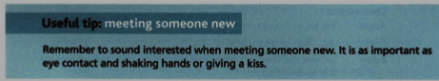
SELF STUDY.

Slide 13
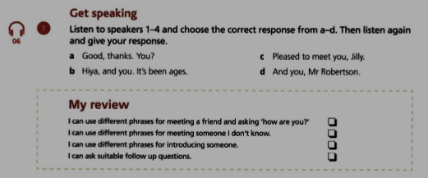

Slide 14
HERE ARE SOME WEBSITES TO VISIT AND STUDY FOR BETTER. REMEMBER! PRACTICE MAKES IT PERFECT!
https://learnenglish.britishcouncil.org/skills/listening/a1-listening/meeting-people-at-a-dinner
https://learnenglish.britishcouncil.org/skills/listening/a1-listening/meeting-other-students
https://learnenglish.britishcouncil.org/skills/listening/a1-listening/meeting-a-new-team-member
https://www.youtube.com/watch?v=Ln5qotRMJvI ***
https://www.youtube.com/watch?v=T91p6pTPpSY&list=PLD_5T89Ssbn0FbigKmfNXTbQ-bRnWzI57&index=7 ***
https://learnenglishteens.britishcouncil.org/grammar/a1-a2-grammar/present-simple (this is for grammar, topic 1- present simple.)

